Slide 1



Python Programming Full Stack Development
Milan Anant
Cyber security trainer

Slide 2


UNIT - 2

Slide 3
What is Functions?
A function is a block of code that only runs when it is called.
You can pass data, known as parameters, into a function.
A function can return data as a result.
Creating a Function
In Python, a function is defined using the def keyword

Slide 4

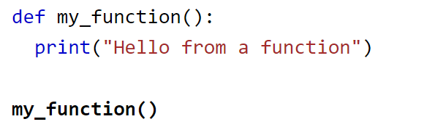
Example:
Calling a Function:
To call a function, use the function name followed by parenthesis.
Example:

Slide 5
Arguments
Information can be passed into functions as arguments.
Arguments are specified after the function name, inside the parentheses. You can add as many arguments as you want, just separate them with a comma.
The following example has a function with one argument (fname). When the function is called, we pass along a first name, which is used inside the function to print the full name:

Slide 6
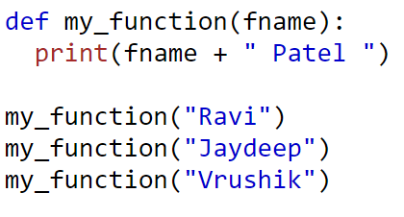
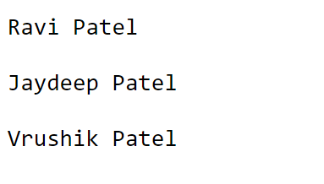

Example:
Output:

Slide 7

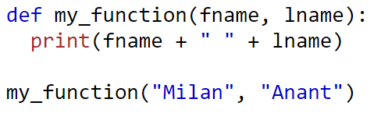
Number of Arguments
By default, a function must be called with the correct number of arguments. Meaning that if your function expects 2 arguments, you have to call the function with 2 arguments, not more, and not less.
INPUT OUTPUT

Slide 8
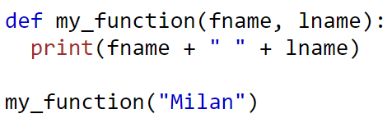
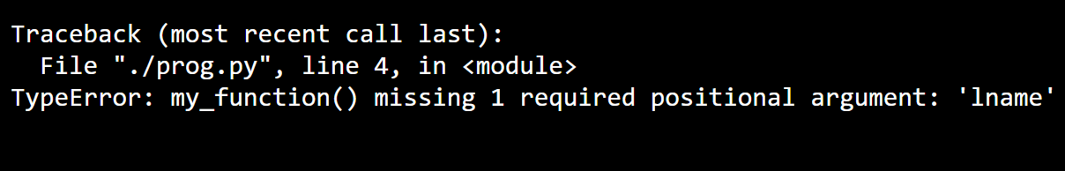
If you try to call the function with 1 or 3 arguments, you will get an error:
Input:
Output:

Slide 9
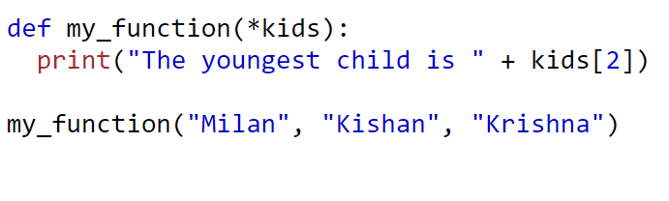

Arbitrary Arguments, *args
If you do not know how many arguments will be passed into your function, add a * before the parameter name in the function definition.
This way the function will receive a tuple of arguments, and can access the items accordingly
Input Output

Slide 10
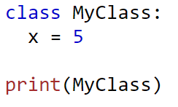
Python Classes/Objects
Python is an object-oriented programming language.
Almost everything in Python is an object, with its properties and methods.
A Class is like an object constructor or a "blueprint" for creating objects.
To create a class, use the keyword class:

Slide 11
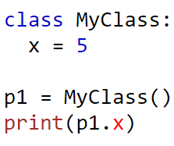

Now we can use the class named MyClass to create objects:
Create an object named p1, and print the value of x:
Input Output

Slide 12
The __init__() Function
The examples above are classes and objects in their simplest form and are not really useful in real life applications.
To understand the meaning of classes we have to understand the built-in __init__() function.
All classes have a function called __init__(), which is always executed when the class is being initiated.
Use the __init__() function to assign values to object properties, or other operations that are necessary to do when the object is being created:real-life

Slide 13
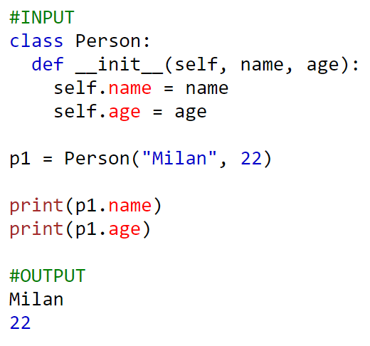
Example
Create a class named Person, use the __init__() function to assign values for name and age:

Slide 14
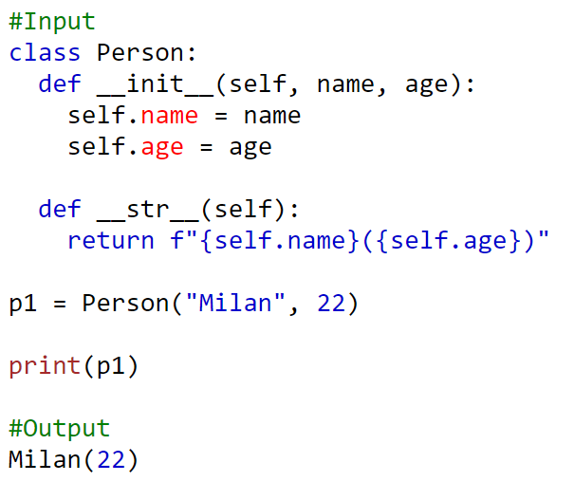
The __str__() Function
The __str__() function controls what should be returned when the class object is represented as a string.

Slide 15
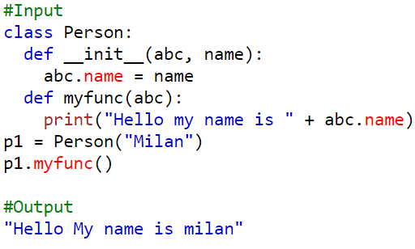
The self Parameter
The self parameter is a reference to the current instance of the class and is used to access variables that belong to the class.
It does not have to be named self , you can call it whatever you like, but it has to be the first parameter of any function in the class:

Slide 16
Modify Object Properties:
You can modify properties on objects like this:
Set the age of p1 to 40:
p1.age = 40
You can delete properties on objects by using the del keyword
del p1.age
You can delete objects by using the del keyword
del p1

Slide 17
What is Abstraction in Python?
Abstraction focuses on hiding the internal implementations of a process or method from the user. In this way, the user knows what he is doing but not how the work is being done.
For example, people do not think of a car as a set of thousands of individual parts. Instead, they see it as a well-defined object with its own unique behavior. This abstraction allows people to use a car to drive without knowing the complexity of the parts that form the car. They can ignore the details of how the engine transmission and braking systems work. Instead, they are free to utilize the object as a whole.
A powerful way to manage abstraction is through the use of hierarchical classification. This allows us to layer the semantics of complex systems, breaking them into more manageable pieces. From the outside, a car is a single object. Once inside, you see that the car consists of several subsystems: steering, brakes, sound system, seat belts, etc. In turn, each of these subsystems is made up of smaller units.

Slide 18
To declare an Abstraction class, we first need to import the abc module. Let us look at an example.
from abc import ABC class abs_class(ABC):
Here, abc_class is the abstract class inside which abstract methods or any other sort of methods can be defined.
As a property, abstract classes can have any number of abstract methods coexisting with any number of other methods. For example, we can see below.
from abc import ABC, abstractmethod class abs_class(ABC): #normal method def method(self): #method definition @abstractmethod def Abs_method(self): #Abs_method definition
Here, method() is normal method whereas Abs_method() is an abstract method implementing @abstractmethod from the abc module.

Slide 19
Python Abstraction Example
from abc import ABC, abstractmethod class Animal(ABC): @abstractmethod def make_sound(self): pass @abstractmethod def move(self): pass class Cat(Animal): def make_sound(self): print("Meow!") def move(self): print("Cat is walking.") class Dog(Animal): def make_sound(self): print("Woof!") def move(self): print("Dog is running.") cat = Cat() cat.make_sound() cat.move() dog = Dog() dog.make_sound() dog.move()

Slide 20
What is Encapsulation?
When working with classes and dealing with sensitive data, providing global access to all the variables used within the program is not a good choice. Encapsulation offers a way for us to access the required variables without providing the program full-fledged access to any of those variables.
Updating, modifying, or deleting data from variables can be done through the use of methods that are defined specifically for the purpose. The benefit of using this approach to programming is improved control over the input data and better security.

Slide 21
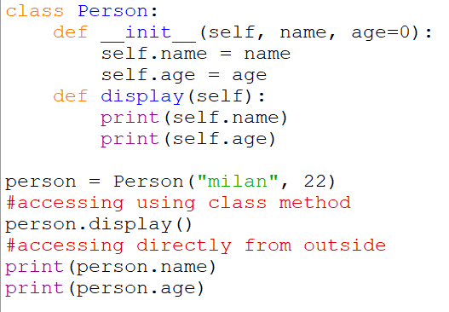
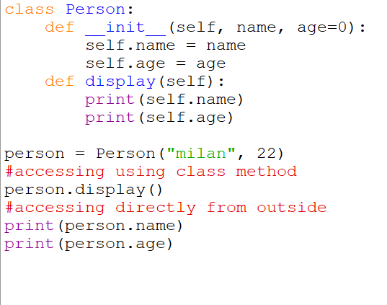
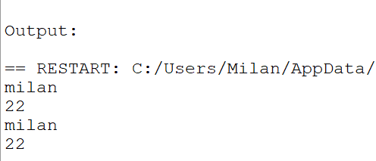
Compared to languages like Java that offer access modifiers (public or private) for variables and methods, Python provides access to all the variables and methods globally.
Check the below demonstration of how variables can easily be accessed.

Slide 22
Methods to Control Access:
There are multiple methods that are offered by Python to limit variable and method access across the program. Let’s go over the methods in detail.
Using Single Underscore
A common Python programming convention to identify a private variable is by prefixing it with an underscore. Now, this doesn’t really make any difference on the compiler side of things. The variable is still accessible as usual. But being a convention that programmers have picked up on, it tells other programmers that the variables or methods have to be used only within the scope of the class.

Slide 23
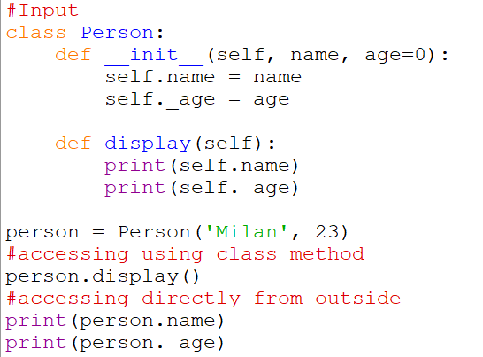
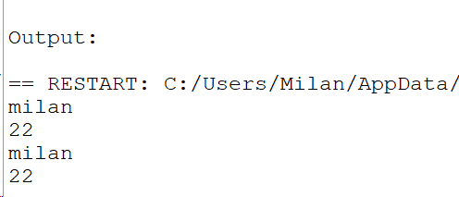
It’s clear that the variable access is unchanged. But can we do anything to really make it private? Let’s have a look further.

Slide 24
Using Double Underscores
If you want to make class members i.e. methods and variables private, then you should prefix them with double underscores. But Python offers some sort of support to the private modifier. This mechanism is called Name mangling. With this, it is still possible to access the class members from outside it.
In Python, any identifier with __Var is rewritten by a Python interpreter as _Classname__Var, and the class name remains as the present class name. This mechanism of changing names is called Name Mangling in Python. In the below example, in Class person, the age variable is changed and it’s prefixed by leading double underscores.

Slide 25
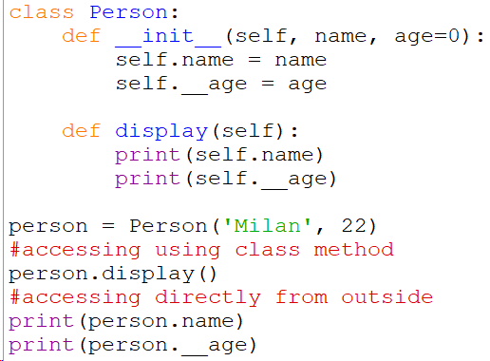
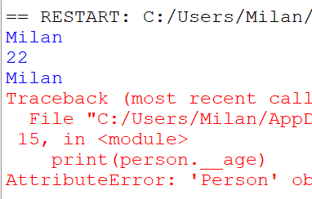
You can observe that variables are still be accessed using methods, which is a part of the class. But you cannot access age directly from outside, as it is a private variable.

Slide 26
What is the need for Encapsulation in Python
Encapsulation helps in achieving the well-defined interaction in every application.
The Object-Oriented concept focuses on the reusability of code in Python. (DRY – Don’t Repeat Yourself).
The applications can be securely maintained.
It ensures the flexibility of the code through a proper code organization.
It promotes a smooth experience for the users without exposing any back-end complexities.
It improves the readability of the code. Any changes in one part of the code will not disturb another.a

Slide 27
Polymorphism in Python
Polymorphism means having vivid or different forms. In the programming world, Polymorphism refers to the ability of the function with the same name to carry different functionality altogether. It creates a structure that can use many forms of objects.
This permits functions/arguments to use entities of different types at different times. In object-oriented programming, Polymorphism allows a particular object referring to a particular class to be used similarly as if it was a different object referring to altogether a different class.

Slide 28
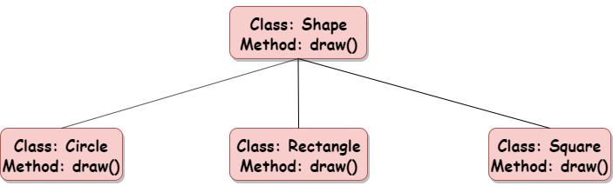

Slide 29
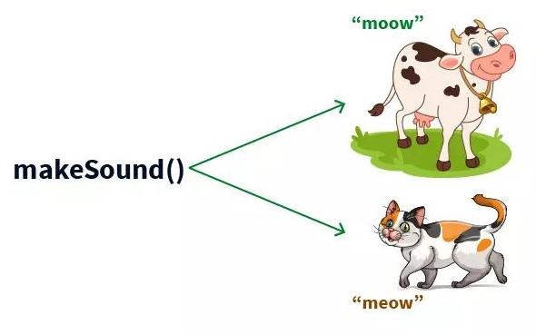
Implementing Polymorphism in Python with Class:
Python can use different types of classes, in the same way, using Polymorphism. To serve this purpose, one can create a loop that iterates through a tuple of objects. Post which, one can call the methods without having a look at the type of class to which the object belongs to.

Slide 30
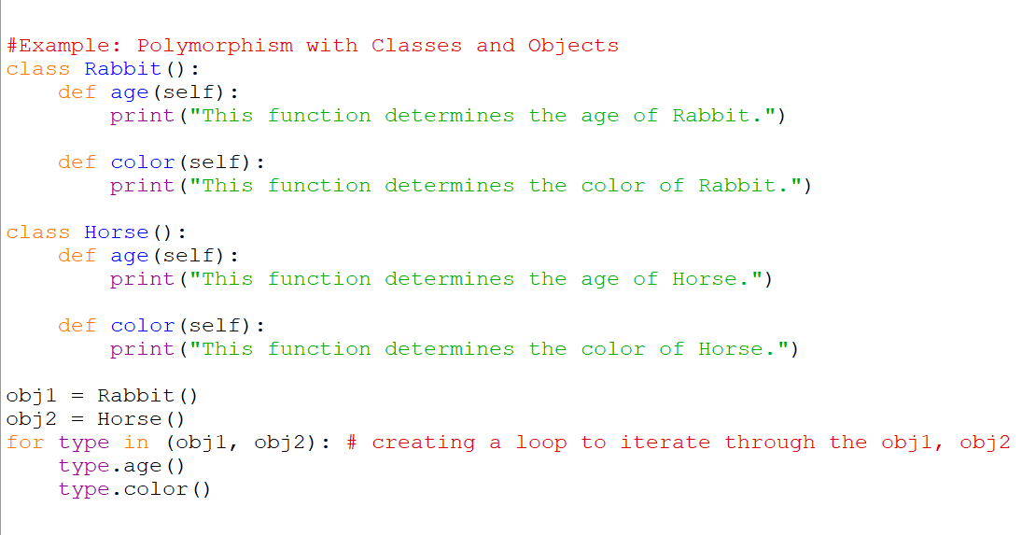

Slide 31
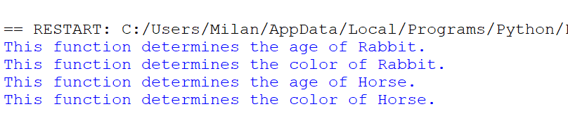
Implementing Polymorphism in Python with Inheritance:
We will be defining functions in the derived class that have the same name as the functions in the base class. Here, we re-implement the functions in the derived class. The phenomenon of re-implementing a function in the derived class is known as Method Overriding.

Slide 32
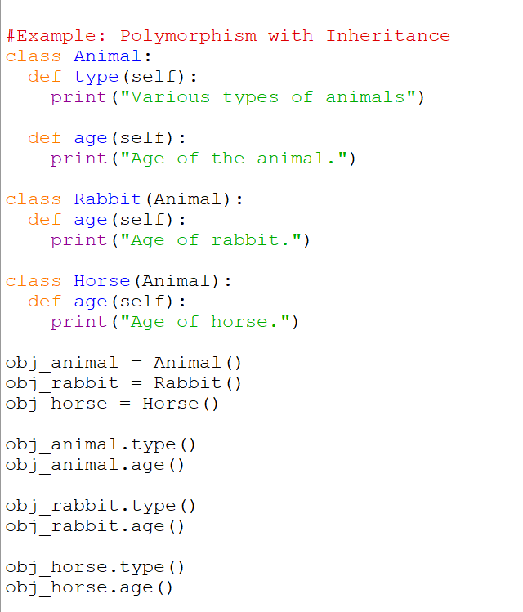

Slide 33
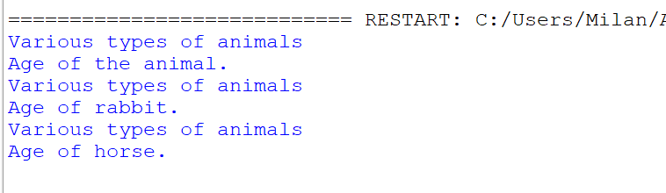
Advantages of Polymorphism:
The codes and classes written once can be reused and implemented multiple times.
It helps in reducing the coupling between different functionalities and behavior of objects.

Slide 34
Inheritance in Python
In the world of Object-Oriented Programming (OOP), Inheritance refers to the mechanism of the capability of a class to derive or extend the properties from another class in the run.
This property enables the derived class to acquire the properties or traits of the base class. Inheritance is considered one of the most important aspects of OOP because it serves the feature of reusability, thus making the piece of code more reliable.

Slide 35
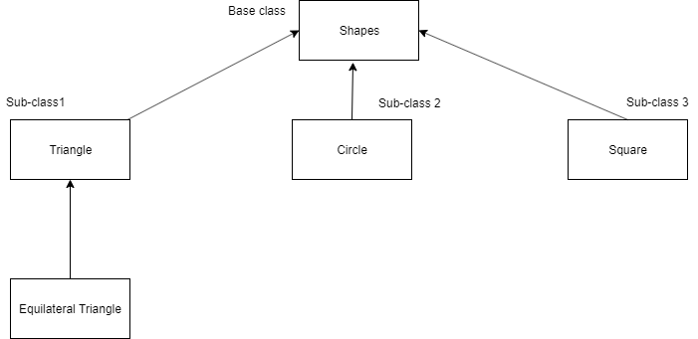

Slide 36
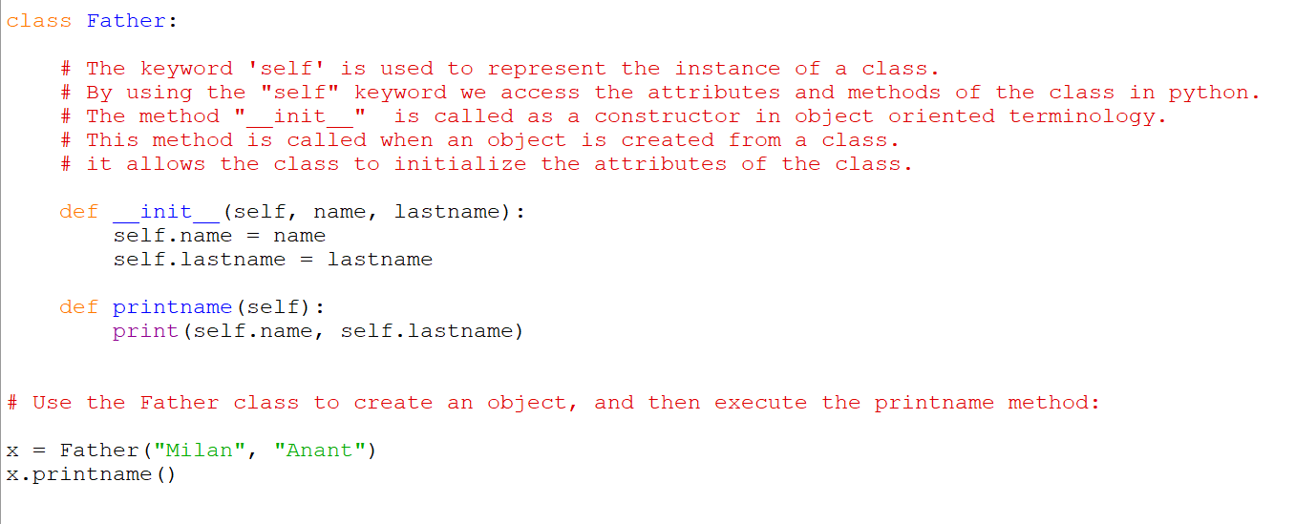
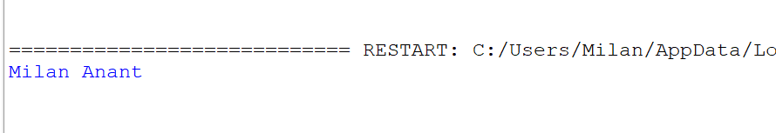
Let’s dive into the world of inheritance in Python with simple examples.
Step 1: Create a Base class

Slide 37
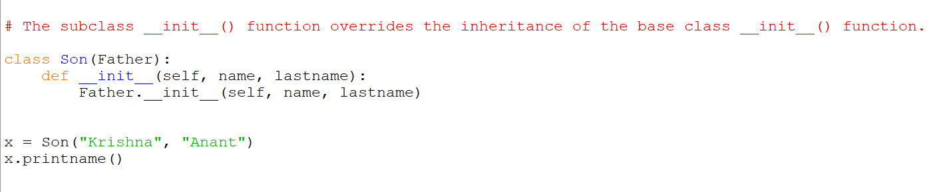
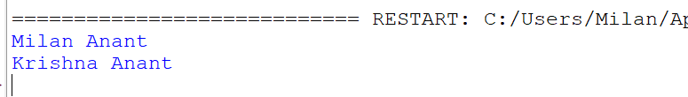
Step 2: Create a Derived class:
Use of super() function:
By using the super() function, you do not have to use the name of the parent element, it will automatically inherit the methods and properties from its parent.

Slide 38
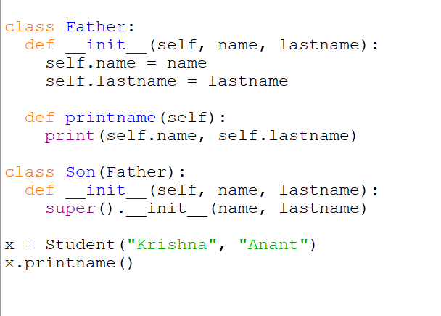


Slide 39
Benefits of Inheritance:
Inheritance depicts relationships that resemble real-world scenarios.
It provides the feature of re-usability which allows the user to add more features to the derived class without altering it.
If a class Y inherits from class X, then automatically all the sub-classes of Y would inherit from class X.

Slide 40
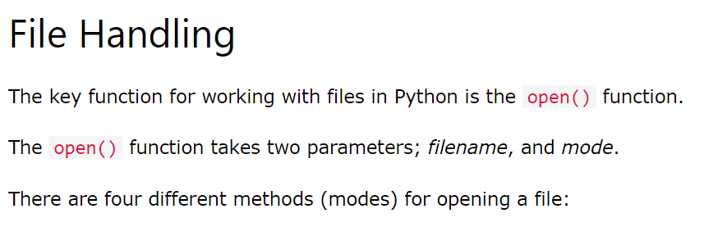
Exceptions and File Handling

Slide 41
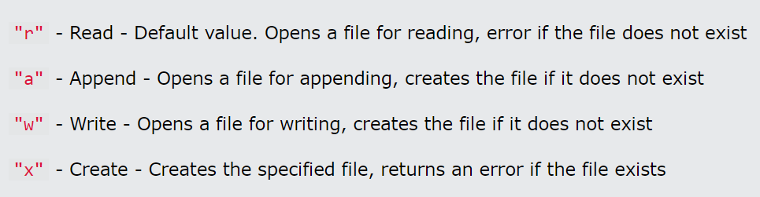
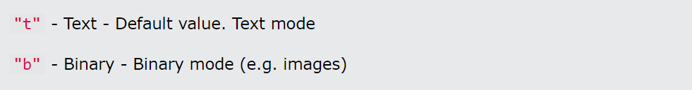

Slide 42


Syntax:
To open a file for reading it is enough to specify the name of the file:
f = open("demofile.txt")
The code above is the same as:
Because "r" for read, and "t" for text are the default values,
you do not need to specify them.

Slide 43
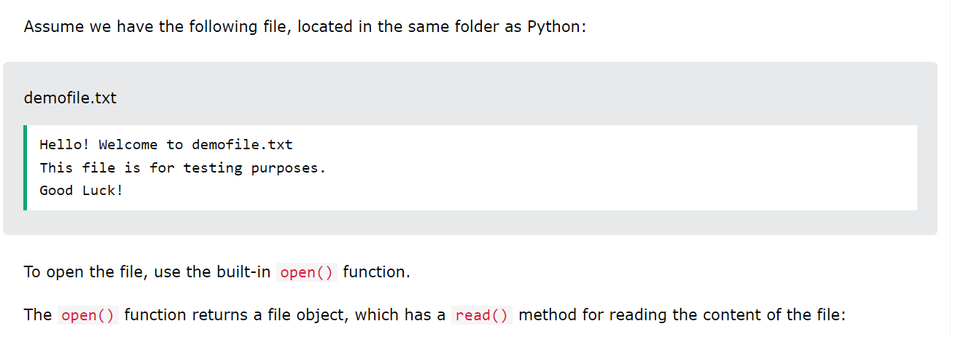

Python File Open And Read:

Slide 44






Slide 45
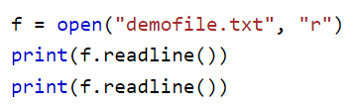
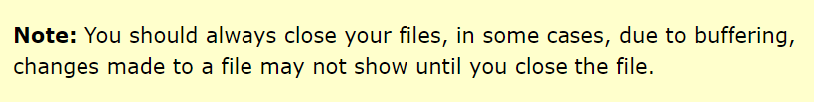
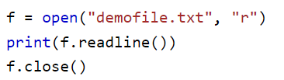

Slide 46
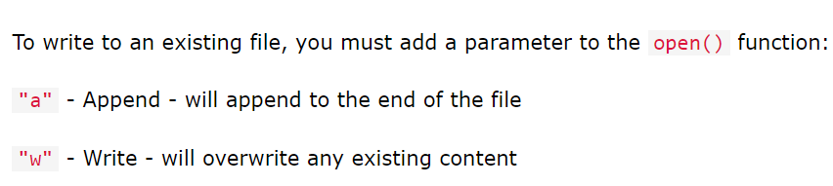
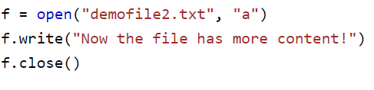
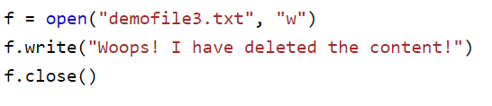
Python File Write:

Slide 47
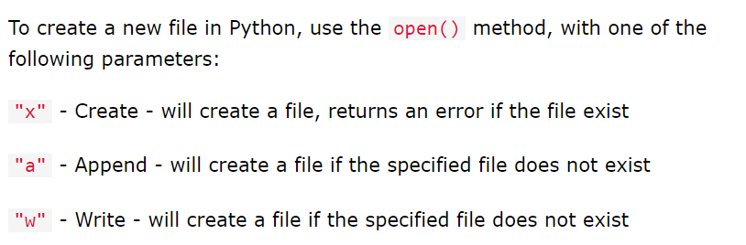
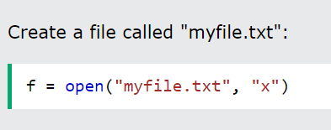
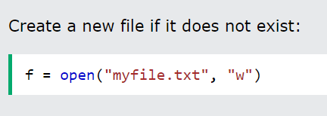

Slide 48




Python Delete File:

Slide 49
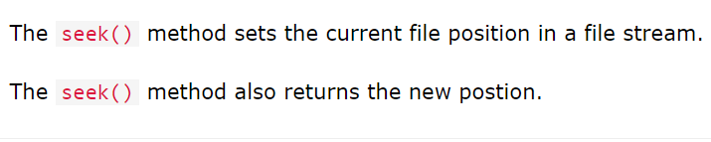
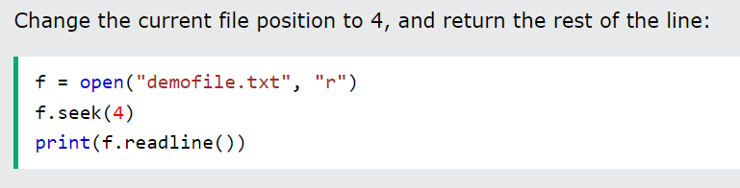
Python File seek() Method:

Slide 50
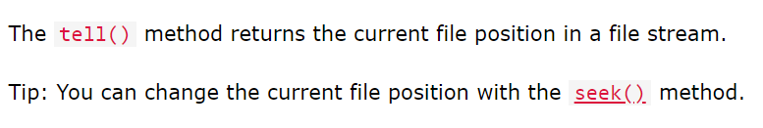

Python File tell() Method:

Slide 51
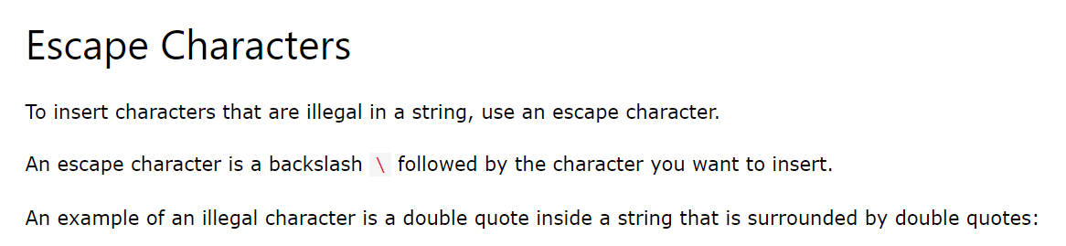
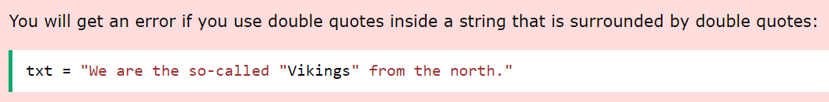

Python Escape Characters:

Slide 52
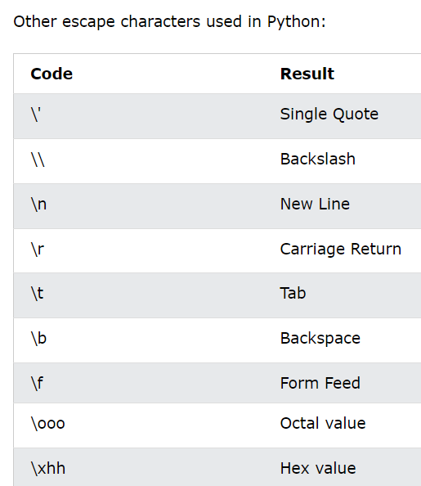

Slide 53
Thank You!

